Slide 1

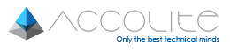
Big Data
How it is changing the World…
By – Amit Arora
i-Learn | a T&D initiative

Slide 2

Agenda
What is Big Data?
The 3 Vs of Big Data
The Growth of Data
How is Big Data Being Used
Big Data Technologies
Challenges enroute Big Data
i-Learn | a T&D initiative

Slide 3
What is Big Data?
i-Learn | a T&D initiative

Slide 4
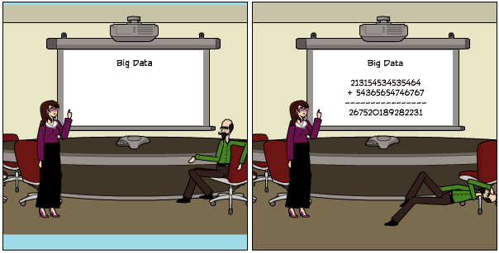
What is Big Data?
i-Learn | a T&D initiative

Slide 5
What is Big Data?
Big Data relates to rapidly growing, Structured and Unstructured datasets with sizes beyond the ability of conventional database tools to store, manage, and analyze them. In addition to its size and complexity, it refers to its ability to help in “Evidence-Based” Decision-making, having a high impact on business operations
i-Learn | a T&D initiative

Slide 6
cloud computing
data visualization
anonymization
weblog analytics
Hive
behavioral analytics
data scientist
MongoDB
recommendation engine
Hadoop
machine learning
sentiment analysis
exabyte
map/reduce
distributed processing
NoSQL
Pig
predictive analytics
petabyte
unstructured data
data aggregation
i-Learn | a T&D initiative

Slide 7
cloud computing
data visualization
anonymization
weblog analytics
Hive
behavioral analytics
data scientist
MongoDB
recommendation engine
Hadoop
machine learning
sentiment analysis
exabyte
map/reduce
distributed processing
NoSQL
Pig
predictive analytics
petabyte
unstructured data
data aggregation
i-Learn | a T&D initiative

Slide 8
The 3, no, 5 Vs of Big Data
i-Learn | a T&D initiative

Slide 9
Big Data is Defined by Volume, Variety and Velocity
V
Value
Volume
5
1
All that you can gain
from all possible modes of use of the data
Large quantity of data which may be enterprise-specific or general and public or private
Veracity
Variety
4
2
Messiness or trustworthiness of the data
Diverse set of data being created, such as social networking feeds, video and audio files, email, sensor data and other raw data
Velocity
3
Speed of data inflow as well as rate at which this fast-moving data needs to be stored
i-Learn | a T&D initiative

Slide 10
Data Volume, Variety, Velocity
Zetabytes
CAGR
(2009-2020)
41.0%
40.0
7.9
1.9
0.8
2009
2011
2015
2020
i-Learn | a T&D initiative

Slide 11
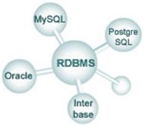

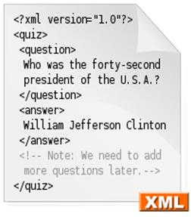
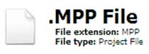





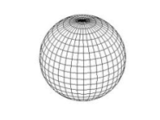

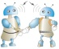
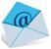



Data Volume , Variety, Velocity
Structured Data
Semi-Structured Data
Resides in formal data stores – RDBMS and Data Warehouse; grouped in the form of rows or columns
Accounts for ~10% of the total data existing currently
A form of structured data that does not conform with the formal structure of data models
Accounts for ~10% of the total data existing currently
RDBMS (e.g., ERP and CRM
Data Warehousing
Microsoft Project Plan File
RSS
XML
Unstructured Data
Comprises data formats which cannot be stored in row/ column format like audio files, video, clickstream data,
Accounts for ~80% of the total data existing currently
Weather patterns
Location co-ordinates
Video
Audio
Text message
Blogs
Web logs & clickstreams
Sensor data/ M2M
Geospatial data
Email
Social media
i-Learn | a T&D initiative

Slide 12
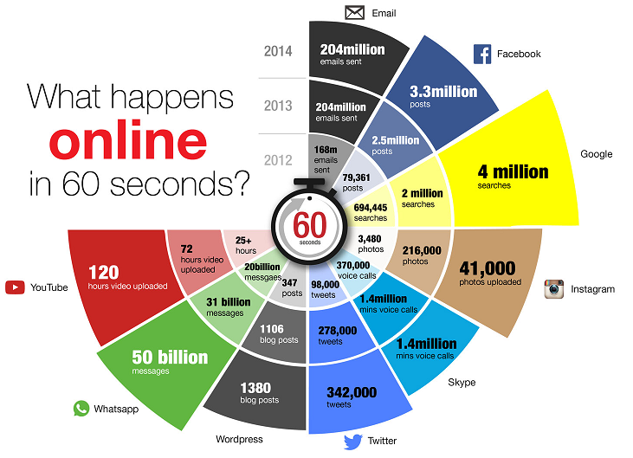
Data Volume, Variety , Velocity
i-Learn | a T&D initiative

Slide 13
The growth of Data
i-Learn | a T&D initiative

Slide 14
Volume, Variety, Velocity Facts
Every 2 days
we create as much information as we did from the beginning of time until 2003.
Source
It is expected
that by 2020 the amount of digital information will have grown from 7.9 zettabytes today to 40 zettabytes.
Source
Over 90% of all the data in the world was created in the past 2 years.
Source
The amount of data transferred over mobile networks increased by 81% to 1.5 exabytes per month between 2012 and 2014. Video accounts for 53% of that total.
Source
If you burned
all of the data created in just one day onto DVDs, you could stack them on top of each other and reach the moon
– twice.
Source
570 new websites spring into existence every minute of every day.
Source
i-Learn | a T&D initiative

Slide 15
Volume, Variety, Velocity Facts
The number
of Bits of information stored in the digital universe is thought to have exceeded the number of stars in the physical universe in 2007.
Source
The NSA
is thought to analyze 1.6% of all global internet traffic – around 30 petabytes (30 million gigabytes) every day.
Source
Today’s data centres occupy an area of land equal in size to almost 6,000 football fields.
Source
This year,
there will be over 1.2
billion smart phones in the world (which are stuffed full of sensors and data collection features), and the growth is predicted to continue.
Source
The boom of
the Internet of Things
will mean that the amount of devices connected to the Internet will rise from about 13 billion today to
50 billion by 2020.
Source
12 million RFID tags
– used to capture data and track movement of objects in the physical world – had been sold by 2011. By 2021, it is estimated that number will have risen to 209 billion as the Internet of Things takes off.
Source
i-Learn | a T&D initiative

Slide 16
How is Big Data being used?
i-Learn | a T&D initiative

Slide 17
Example 1 - Better understand and target customers
To better understand and target customers, companies expand their traditional data sets with social media data, browser, text analytics or sensor data to get a more complete picture of their customers
The big objective, in many cases, is to create predictive models
Telecom companies can now better predict customer churn
Retailers can predict what products will sell
Car insurance companies understand how well their customers actually drive
i-Learn | a T&D initiative

Slide 18
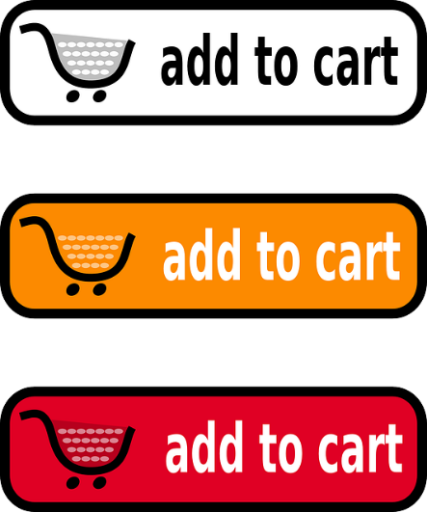

Amazon - Behavioral Analytics
‘customers who bought this…’ feature
Recommendations are based on user’s wish list, the items they have reviewed and what similar people have purchased
Only company that have a patent that allows them to ship goods before an order has even been placed
i-Learn | a T&D initiative

Slide 19
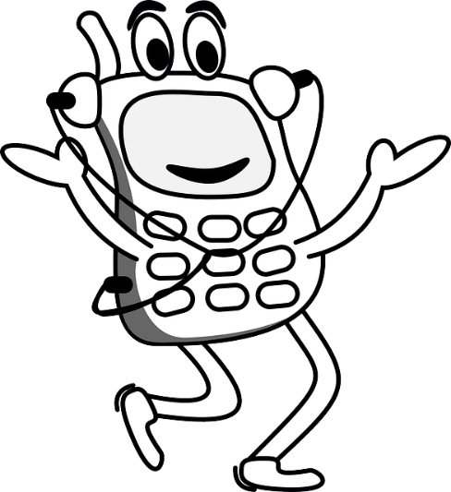

T-mobile - Optimize Funnel Conversion
Uses multiple indicators, such as billing and sentiment analysis, to identify customers that can be upgraded to higher quality products
Uses similar analytics to identify those with a high lifetime customer-value, so its team can focus on retaining those customers.
i-Learn | a T&D initiative

Slide 20
Example 2 - Understand & Optimize Business Process
Big data is being increasingly used to optimize business processes
Retailers are able to optimize their stock based on predictive models generated from social media data, web search trends and weather forecasts
Another example is supply chain or delivery route optimization using data from geographic positioning and radio frequency identification sensors
i-Learn | a T&D initiative

Slide 21

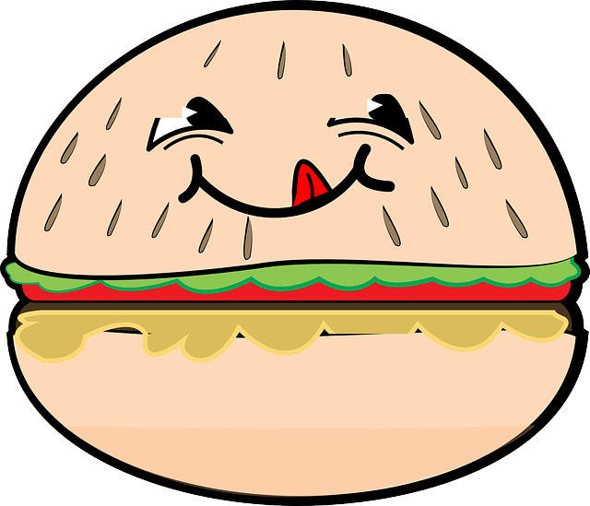
McDonalds - Operational Efficiency
McDonalds tracks vast amounts of data in order to improve operations and boost the customer experience
The company looks at factors such as the design of the drive-thru, information provided on the menu, wait times, the size of orders and ordering patterns in order to optimize each restaurant to its particular market
i-Learn | a T&D initiative

Slide 22
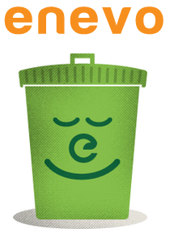

Enevo – Operational Efficiency
Enevo, a Finnish company, installed 5,000 sensors in garbage cans to alert collection companies when containers are nearing full capacity
Saved 40% of otherwise wasted fuel on needless garbage collection rounds
i-Learn | a T&D initiative

Slide 23
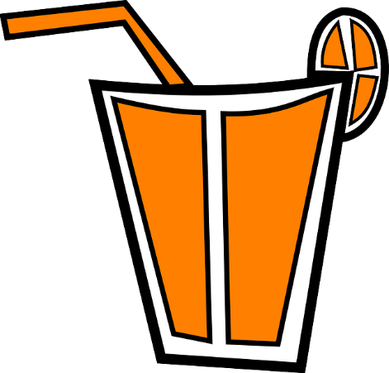

Coca Cola - Market Basket Analysis
Coca-Cola uses vast amounts of data and an algorithm to ensure that its orange juice has a consistent taste throughout the year.
The algorithm incorporates satellite imagery, crop yields, consumer preferences and details about the flavours that make up a particular fruit in order to determine how the juice should be blended.
i-Learn | a T&D initiative

Slide 24
Example 3 - Improving Health
The computing power of big data analytics enables us to find new cures and better understand and predict disease patterns.
We can use all the data from smart watches and wearable devices to better understand links between lifestyles and diseases.
Big data analytics also allow us to monitor and predict epidemics and disease outbreaks, simply by listening to what people are saying, i.e. “Feeling rubbish today - in bed with a cold” or searching for on the Internet, i.e. “cures for flu”.
i-Learn | a T&D initiative

Slide 25

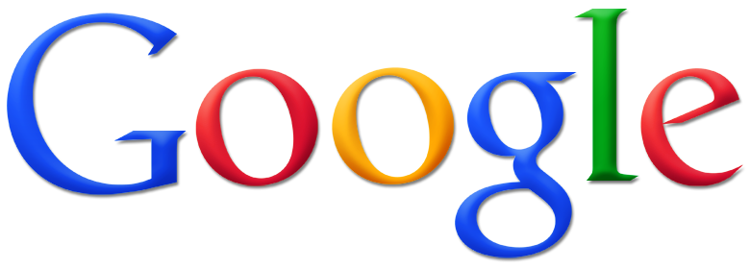
Google Flu Trends
A web service operated by Google to provide estimates of influenza activity for more than 25 countries
Aggregates Google search queries to reveal if there is the presence of flu-like illness
Predicted spread of flu 15 days prior to the CDC report
In 2009, predictions were 97% accurate
Of late, predictions have over-estimated flu cases
Google launched Dengue Trends on lines of GFT
i-Learn | a T&D initiative

Slide 26
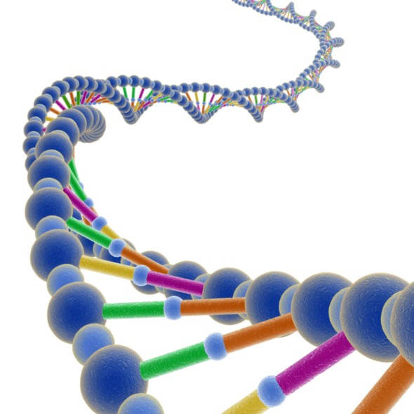

Medical Research
In Medical Research two main application are:
– Genomic Sequence Collections (A single sequencing experiment yield 100 million short sequences)
– Analysis of neuro-imaging data (Intermediate data stored ~ 1.8 PetaBytes)
i-Learn | a T&D initiative

Slide 27


Healthcare – Predict Life threatening infections
IBM and the University of the Ontario Institute of Technology have been working on a data analysis and predictive solution to monitor premature babies.
Biomedical readings can detect life threatening infections up to 24 hours before they would normally be observed.
i-Learn | a T&D initiative

Slide 28
Example 4 - Improving Security & Law Enforcement
Security services use big data analytics to foil terrorist plots and detect cyber attacks
Police forces use big data tools to catch criminals and even predict criminal activity
Credit card companies use big data analytics to detect fraudulent transactions
i-Learn | a T&D initiative

Slide 29
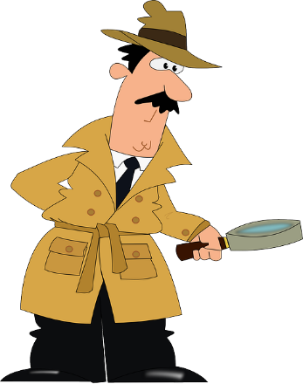

Discovery Health - Fraud Detection
Discovery Health uses big data analytics to identify fraudulent claims and possible fraudulent prescriptions.
For example, it can identify if a healthcare provider is charging for a more expensive procedure than was actually performed.
i-Learn | a T&D initiative

Slide 30
Example 5 - Improving Sports Performance
Most elite sports have now embraced big data analytics.
Many use video analytics to track the performance of every player in a football or cricket game
Sensor technology is built into sports equipment such as basket balls or golf clubs
Many elite sports teams track athletes outside of the sporting environment – using smart technology to track nutrition and sleep, as well as social media conversations to monitor emotional wellbeing.
i-Learn | a T&D initiative

Slide 31
Example 6 – Improving/Optimizing Cities & Countries
Big data is used to improve many aspects of our cities and countries
It allows cities to optimize traffic flows based on real time traffic information as well as social media and weather data
A number of cities are currently using big data analytics with the aim of turning themselves into Smart Cities, where the transport infrastructure and utility processes are all joined up
Eg - a bus would wait for a delayed train
Eg - traffic signals predict traffic volumes and operate to minimize jams
i-Learn | a T&D initiative

Slide 32
Example 7 to ∞ - Imagination is the limit…
Big data solutions are being used in creative and creative ways in all spheres of life
From politics to entertainment
From space exploration to application support
From candidate recruitment to customer delight…
i-Learn | a T&D initiative

Slide 33



Politics – Define/Refine Political Campaigns
Obama’s election campaigns– data analytics were the president’s go-to tool
Once it had come to light that 64% of voters were using online forums in order to verify a claim that had been made by a candidate, they knew who they had to persuade and what they were unsure about
It also allowed insights to be leveraged in real time without much lag, giving Obama an awareness of what people were discussing and a platform to speak to people about the things that were concerning them
During India's last year’s general elections, parties actively used big data analysis to connect with voters, raise funds, rework advertisements and create detailed models for voter engagement in swing states
Remember the recent “sweeping broom”?
i-Learn | a T&D initiative

Slide 34
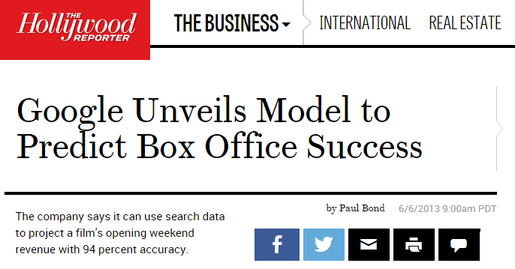
Entertainment – Box Office Success
94% accuracy of opening weekend box office up to 4 weeks pre-release…
i-Learn | a T&D initiative

Slide 35
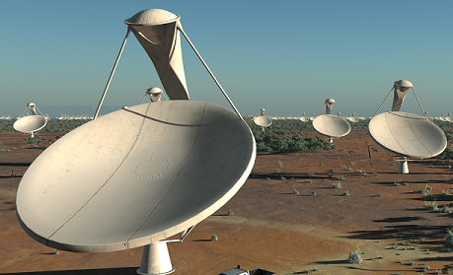
Space Exploration & Observation
In 2018, a group of organizations from all of the world will begin construction of the largest radio telescope ever built, the Square Kilometre Array (SKA).
one million square meters of collecting area and enough optical fiber to wrap around the Earth twice
detect airport radar on a planet 50 light years away
SKA will generate 700 terabytes of data every second
At full capacity, the SKA’s aperture arrays are expected to produce 100 times more data than the entire Internet
i-Learn | a T&D initiative

Slide 36


Morgan Stanley - Predictive Support
Morgan Stanley uses real-time wire data analytics to detect problems in its applications and prioritize which issues should be addressed first.
The company also uses big data to determine the impact of a particular market event, as well as its original cause.
i-Learn | a T&D initiative

Slide 37
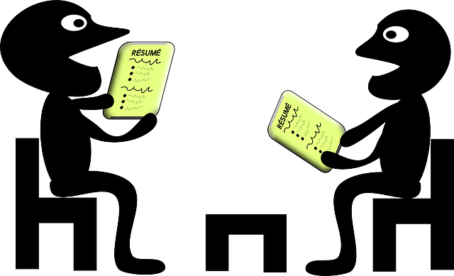

Catalyst IT Services - Recruiting Technology
Catalyst IT Services built a program to screen job candidates based on how the candidate completed a survey.
The program collects thousands of data points, such as how the candidate approaches a difficult question to determine how the candidate works.
Since implementing the program, employee turnover at the company has been reduced to 15 percent.
i-Learn | a T&D initiative

Slide 38


Reputation on Steak – Morton’s!
• Morton Steakhouse sensed an opportunity to improve reputation, brand and buzz by tapping social media
• Performed Data Analytics by
- Continually scanning twitterverse for mentions of their business
- Integrating tweeters with their robust customer management system
• Results
- Saw tweet from a top customer lamenting late flight—no time to dine at Morton’s
- Tuxedo-clad waiter waiting for him when he landed with a bag containing his favorite steak, prepared the way he normally likes it
i-Learn | a T&D initiative

Slide 39

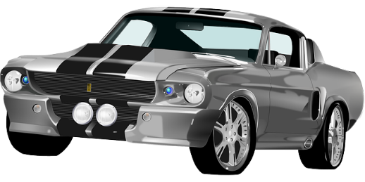
Ford’s Big Data plans
125 new data-related posts to be created at Silicon Valley research and development facility.
Big Data analytics to be leveraged in marketing and sales, finance, purchasing and manufacturing
Study freight and logistics routes to compare the cost of parts on a global basis
Ford Lab in Silicon Valley gathers data from over four million cars with in-car sensors and remote application management software
Installs over 74 sensors in cars including sonar, cameras, radar, accelerometers, temperature sensors and rain sensors
Energi line of plug-in hybrid cars generate over 25 gigabytes of data every hour
Performs sentiment analysis on all sort of content online and uses Google Trends to predict future sales
i-Learn | a T&D initiative

Slide 40
Big Data Technologies
i-Learn | a T&D initiative

Slide 41
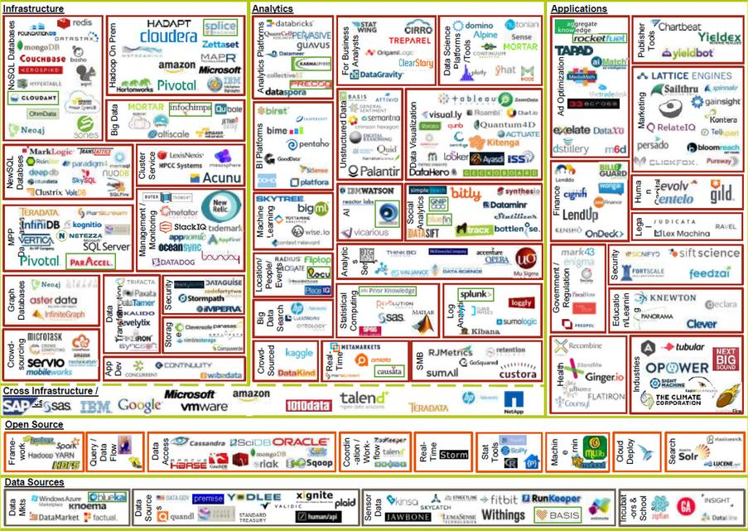
i-Learn | a T&D initiative

Slide 42
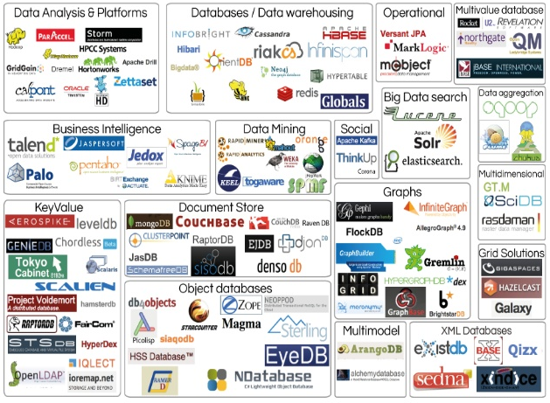
i-Learn | a T&D initiative

Slide 43
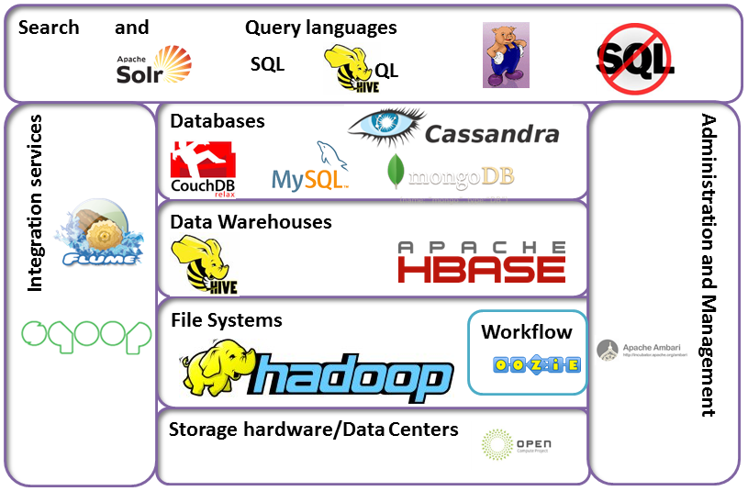
i-Learn | a T&D initiative

Slide 44

i-Learn | a T&D initiative

Slide 45
Challenges enroute Big Data
i-Learn | a T&D initiative

Slide 46
Challenges
If the quantity of information is increasing by 2.5 quintillion bytes per day, the amount of useful information almost certainly isn't.
Most of it is just noise, and the noise is increasing faster than the signal.
There are so many hypotheses to test, so many data sets to mine—but a relatively constant amount of objective truth.
The dictatorship of data - our fascination with data may become a dangerous addiction
Privacy concerns
Propensity - using big data predictions to punish people even before they acted
i-Learn | a T&D initiative

Slide 47
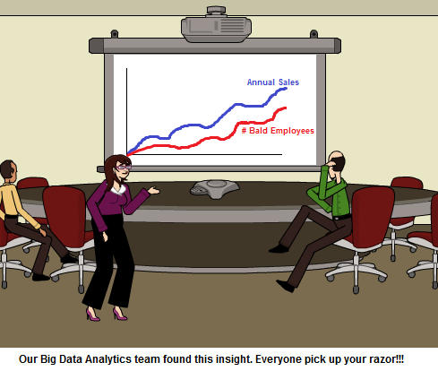
Correlation instead of Causality
Society will need to shed some of its obsession for causality in exchange for simple correlations: not knowing why but only what…
i-Learn | a T&D initiative

Slide 48

Correct Prediction – Unwarranted side effects
• Target runs an analytics backed marketing program – sends promotions to consumers based on their determined life situation
• Leverages Data & Analytics including
- Transaction receipts and other undisclosed information
- Inference engine to predict future needs based on shopping and purchase pattern changes
• Result
- Identified woman was pregnant; even estimated her due date
- Woman was a pregnant teen; her father didn’t know until coupons arrived
- Coupons now sealed
i-Learn | a T&D initiative

Slide 49

The million dollar book!!!
In early April 2011, Peter Lawrence’s The Making of a Fly, was listed on Amazon.com as having 17 copies for sale: 15 used from $35.54, and 2 new from $23,698,655.93 (plus $3.99 shipping)
Two automated programs, one run by seller “bordeebook” and one by seller “profnath,” were engaged in an iterative and incremental bidding war.
Once a day profnath would raise their price to 0.9983 times bordeebook’s listed price. Several hours later, bordeebook would increase their price to 1.270589 times profnath’s latest amount.
I am worth a million Dollars!!!
i-Learn | a T&D initiative

Slide 50
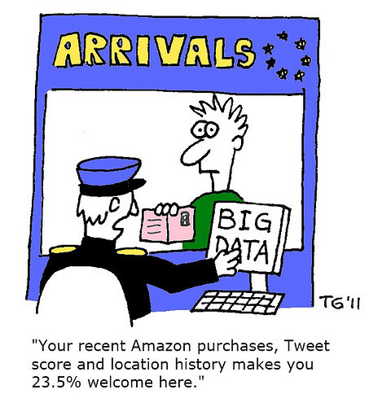
A surprise Welcome!
i-Learn | a T&D initiative

Slide 51
Thank you for your attention!
i-Learn | a T&D initiative

